Slide 1
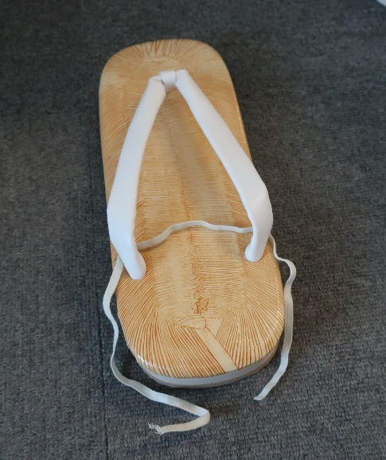
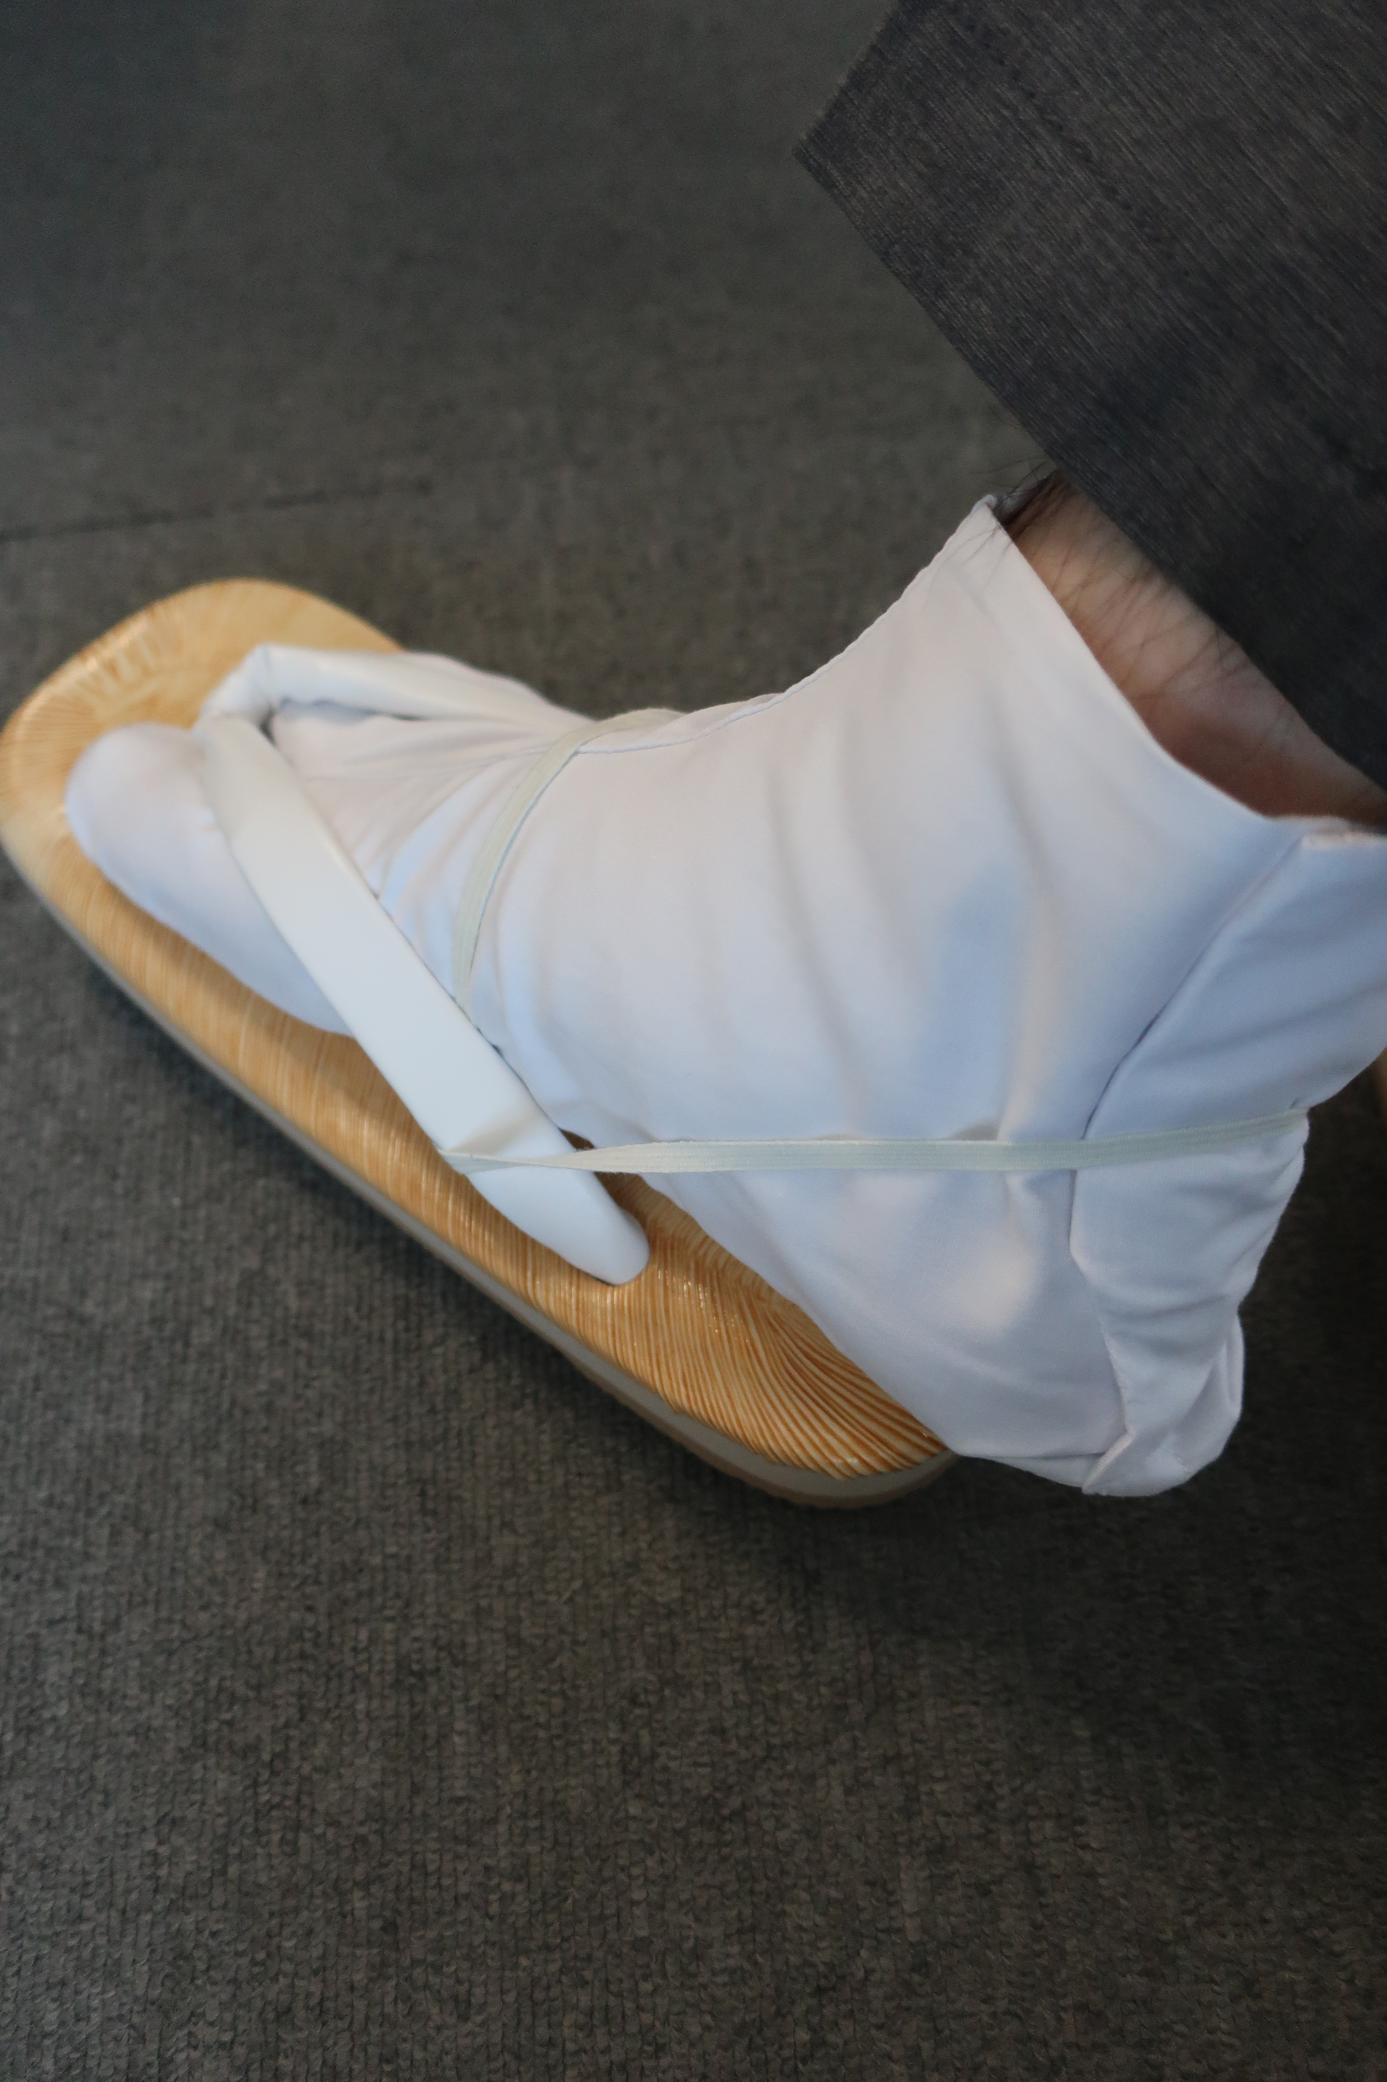
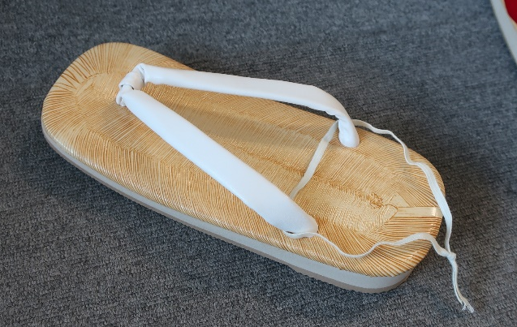
草履 かかと留めについて
How to keep your Zori from slipping
例年、草履が脱げてしまう人がいるので参考でかかと留めの紹介です。
The festival sandal “Zori” is easy to slip off your feet, so here is a way to keep it from slipping.
*In the case of rain or beginners is recommended to do it.
手順１ Step 1
紐を通す Pass through a thin
sewing elastic white band
手順2 Step 2
紐を結ぶ Tie it to match the size of your feet
完成 Done!

